Slide 1



4th ACQF Forum: Micro-credentials for better opportunities
2024.11.14

Slide 2
Agenda
Introduction
African Learning Model (ALM)
QCP User interfaces
Data Collection
Discussion

Slide 3
01
Introduction

Slide 4
Introduction
An introduction to the core concepts and initiatives enhancing qualifications and credentials in Africa within the ACQF Qualifications and Credentials Platform
Today's Focus:
  Aligning Data with the African Learning Model (ALM): Standardizing qualifications data to enhance recognition and mobility across Africa.
  Introducing User Interfaces: Enable user experience to increase engagement and streamline operations.
  Initialising Data Collection Flow: Upcoming Data collection processes, foundational for better decision-making and strategic insights.

Slide 5
02
African Learning Model (ALM)

Slide 6
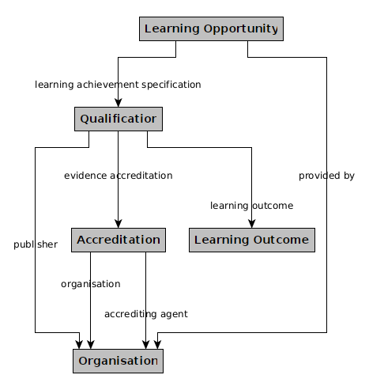
Classes and
Properties
Simplified view
Notes:
@startuml
class Qualification #LightGreen ##[bold]
class LearningOpportunity
class LearningOutcome
class Accreditation
class Organisation
LearningOpportunity --> Qualification : Awarded
LearningOpportunity --> Organisation : Provided by
Qualification --> LearningOutcome : Learning outcome
Qualification --> Accreditation : Accreditation
Accreditation --> Organisation : Accrediting agent, Organisation
@enduml

Slide 7
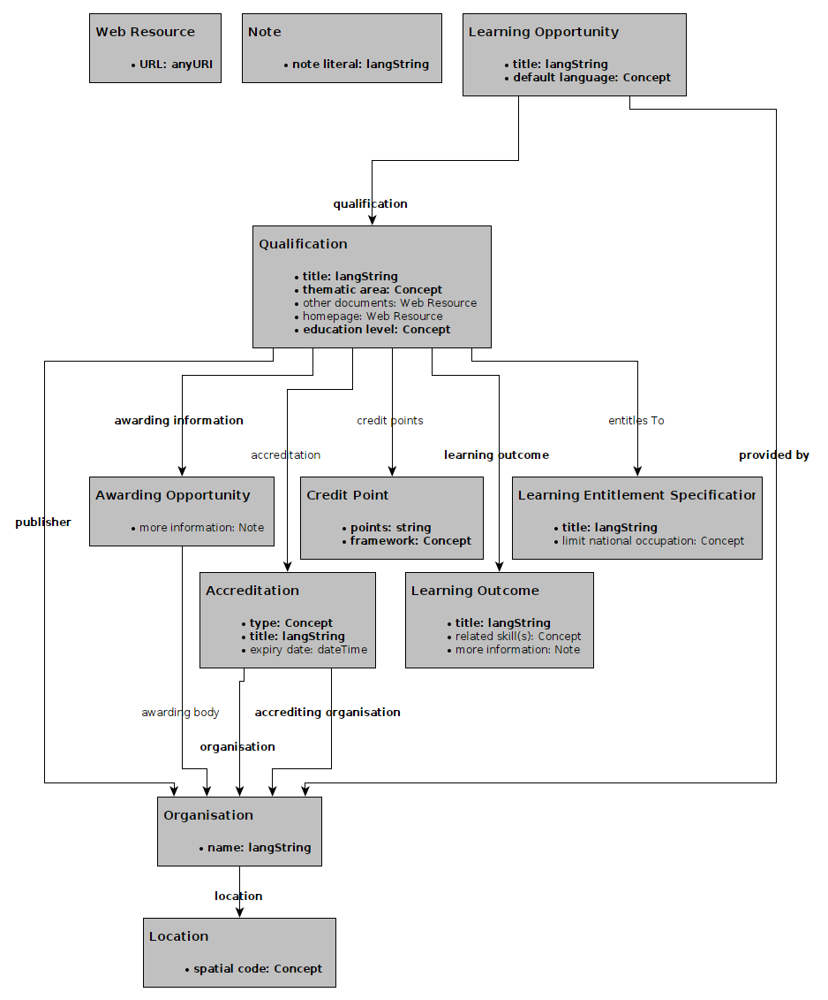
Classes and
Properties
Expanded view
Notes:
@startuml
class Qualification #LightGreen ##[bold]
class LearningOpportunity
class LearningOutcome
class Accreditation
class Organisation
LearningOpportunity --> Qualification : Awarded
LearningOpportunity --> Organisation : Provided by
Qualification --> LearningOutcome : Learning outcome
Qualification --> Accreditation : Accreditation
Accreditation --> Organisation : Accrediting agent, Organisation
@enduml

Slide 8
Classes and
Properties
Notes:
@startuml
class Qualification #LightGreen ##[bold]
class LearningOpportunity
class LearningOutcome
class Accreditation
class Organisation
LearningOpportunity --> Qualification : Awarded
LearningOpportunity --> Organisation : Provided by
Qualification --> LearningOutcome : Learning outcome
Qualification --> Accreditation : Accreditation
Accreditation --> Organisation : Accrediting agent, Organisation
@enduml

Slide 9
Classes and
Properties
Notes:
@startuml
class Qualification #LightGreen ##[bold]
class LearningOpportunity
class LearningOutcome
class Accreditation
class Organisation
LearningOpportunity --> Qualification : Awarded
LearningOpportunity --> Organisation : Provided by
Qualification --> LearningOutcome : Learning outcome
Qualification --> Accreditation : Accreditation
Accreditation --> Organisation : Accrediting agent, Organisation
@enduml

Slide 10
Classes and
Properties
Notes:
@startuml
class Qualification #LightGreen ##[bold]
class LearningOpportunity
class LearningOutcome
class Accreditation
class Organisation
LearningOpportunity --> Qualification : Awarded
LearningOpportunity --> Organisation : Provided by
Qualification --> LearningOutcome : Learning outcome
Qualification --> Accreditation : Accreditation
Accreditation --> Organisation : Accrediting agent, Organisation
@enduml

Slide 11
Overview of properties
Class | Property | Expected value
Qualification | awarding information | Awarding Opportunity
 | education level | ACQF levels
 | learning outcome | Learning Outcome
 | publisher | Organisation
 | thematic area | ISCED-F
 | title | String with language
Awarding Opportunity | awarding body or note | Organisation or Note
Learning Opportunity | default language | Language
 | provided by | Organisation
 | qualification | Qualification
 | title | String with language
Learning Outcome | title | String with language
 | related skill or note | Skill or Note
Location | spatial code | Location code
Organisation | location | Location
 | name | String with language

Slide 12
Controlled lists
Accreditation.type (Controlled List of Accreditation Types)
Credit Point.framework (ACQF Specific)
Learning Entitlement Specification.limit national occupation (ESCO Occupations)
Learning Opportunity. default language (Language Named Authority List)
Learning Outcome. related skill (ESCO Skills)
Location.spatial code (Countries and Territories Authority List)
Qualification.educational level (ACQF Specific)
Qualification.thematic area (ISCED-F 2013)

Slide 13
03
QCP User interface

Slide 14
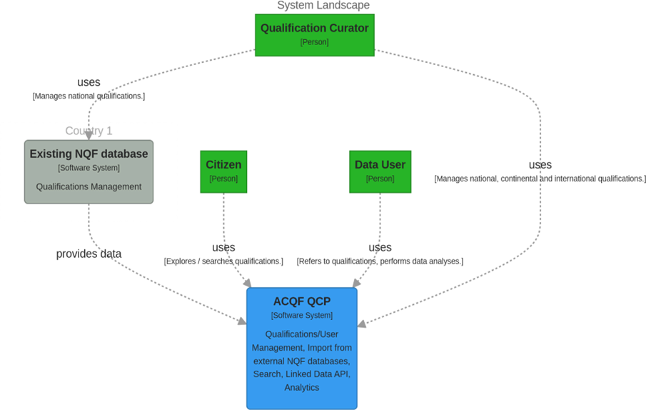
Centralized
System
Architecture
Manage: Virtual Space Administrator
Manage: Administrator

Slide 15
Sections of User Interface
Curator user interface: Provides an interface for curating and editing individual qualifications directly within visual forms.
General Public user interface: Enables the general public to view and explore qualifications.
Import Service user interface: Facilitates the bulk import of qualifications from existing databases.

Slide 16
Today’s showcase
Curator user interface: Provides an interface for curating and editing individual qualifications directly within visual forms.
General Public user interface: Enables the general public to view and explore qualifications.
Import Service user interface: Facilitates the bulk import of qualifications from existing databases.

Slide 17
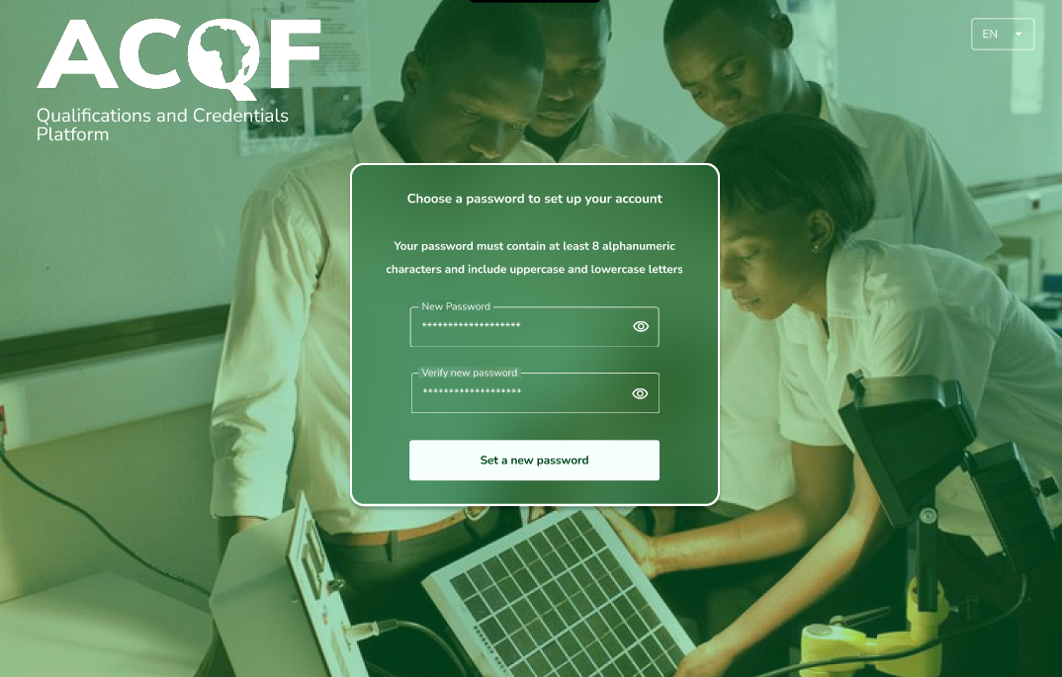
Mockup showcase

Slide 18
04
Data Collection

Slide 19

Data Collection Activity
Build a Unified Database:
Integrate qualifications data across African countries, while ensuring data standardisation, integrity and validation
Coordination with national partners
Understand data state(s) and planned approaches of data insertion
Gathering and standardising qualifications data
Quality assurance and support
Data upload

Slide 20

Data Collection Activity Timeline
2024
Preparatory steps
Workshop
Data collection protocol
Framework set-up, communication with stakeholders
Survey to set KPIs and map data state
Testing file
Quality assurance system
2025
Ongoing (bilateral) support
Ongoing data collection, start of initial upload (Q1)
Monitoring of KPIs: Data collection reports (Q1)
Data validation (Q2)
2nd Data Collection report (Q2)

Slide 21




Data Collection Activity: Immediate steps
Communication framework set up:
QCP Contact persons were established.
Creation of a dedicated mailbox
Quality assurance:
List of actions taken to ensure data is free of error and is high quality
Exact procedure to be circulated by the end of 2024
Test file:
Data template file for familiarising with the ALM
Training for QCP Contact Persons
26 November
4 December

Slide 22
Overview of Data Exchange Modes
Modes designed to cater to various needs and ensure seamless data integration:
Direct Insert Using Curation Portal
Automated Insert Using Import Features

Slide 23
Direct Insert Using Curation Portal
Ideal for countries without established digital qualification databases
Supports those with only document stores (e.g., PDFs)
Features:
  Full user interface (UI) for editing individual qualifications
  Review and quality assurance (QA) processes
  Publication capabilities

Slide 24
Automated Insert Using Import Features
Designed for existing databases wanting public access via the platform
Data is managed as full "sets“
Features:
  Cannot be edited individually
  Subject to QA and republishing by the platform

Slide 25
Defining Organisational Metrics
Purpose:
  Set expectations for collaboration over the next year of data collection.
  Define the Metrics your organisation would like to achieve in this period.
Focus:
  Emphasis on the Direct Insert Using the Curation Portal method.

Slide 26
05
Discussion

Slide 27
Discussion

Slide 28
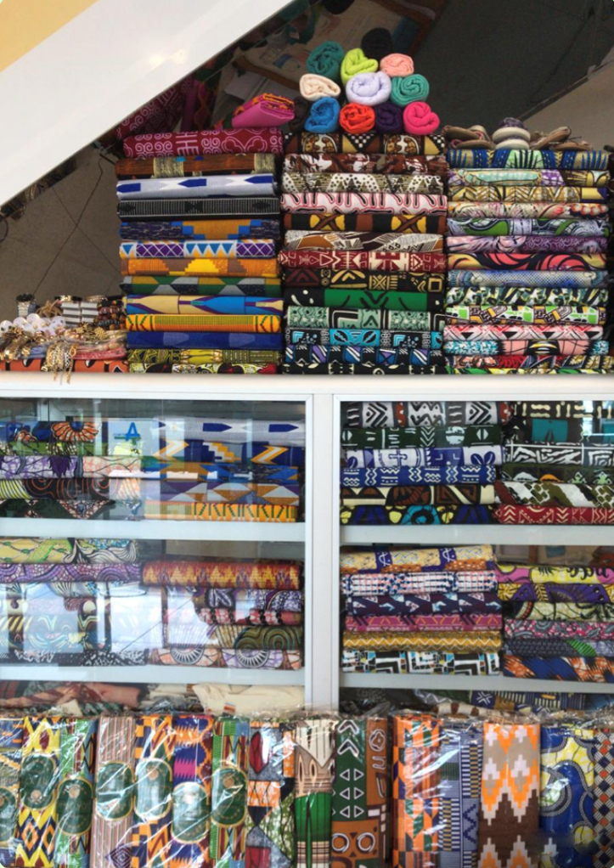
Thank you
Obrigado
Merci

